Slide 1

SETTING UP LOCAL DEV ENVIRONMENT

Slide 2
AGENDA
Development Tools
Setting Class Path
Proxy configuration and Installing Node Packages
Setting up NEXEN Frontend
Setting up NEXEN service

Slide 3
DEVELOPMENT TOOLS
Download and Install for NXN-FrontEnd
Package Managers - Npm & node.js
Node JS
Source Repository - Git
Git
Environment Variable Setup
Add node.js and Git location in environmental properties.
Example: PATH = C:\Program Files\nodejs;C:\Program Files (x86)\Git\bin;%PATH%;
Note that nodejs location should be the first one in the PATH variable, other commands fail, if it is not so.
PATH variable under System Variables also should be appended with “C:\Program Files\nodejs”. Some of us might not have rights to update the System Variable.

Slide 4
DEVELOPMENT TOOLS
Download and Install for NXN-Service
Oracle Database Express
Sql plus client download
Maven
Environment Variable Setup
Add class path for Java and maven.
To check java, node, npm, maven and git versions and whether its installed properly use the below commands
java -version
node -v
npm –v
mvn –v
git --version

Slide 5
DEVELOPMENT TOOLS
Download and Install for NXN-FrontEnd
Package Managers - Npm & node.js
Node JS
Source Repository - Git
Git
Environment Variable Setup
Add node.js and Git location in environmental properties.
Example: PATH = C:\Program Files\nodejs;C:\Program Files (x86)\Git\bin;%PATH%;
Note that nodejs location should be the first one in the PATH variable, other commands fail, if it is not so.
PATH variable under System Variables also should be appended with “C:\Program Files\nodejs”. Some of us might not have rights to update the System Variable.

Slide 6
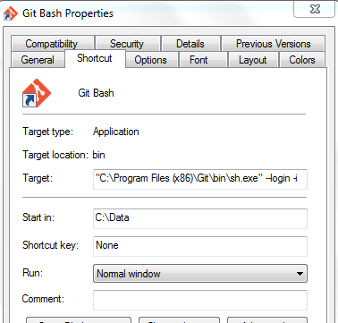
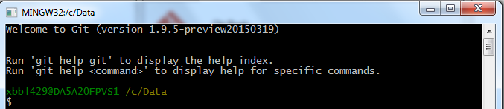
Git Bash Setup and Launch
Change Git bash property : Start → Git Bash → properties (by right clicking)
Change the value of “Start in” to C:\Data
By doing the above, whenever you open your Git bash shell, the default home directly will be c:/Data

Slide 7
Proxy Config
Proxy configuration – do this for every session.
Depending upon your region you need to add proxies to run the npm module installation command.
Via npm config
$npm config set proxy http://proxy.pershing.com:8080
$npm config set https-proxy http://proxy.pershing.com:8080
Via export
export HTTP_PROXY=http://proxy.pershing.com:8080
export HTTPS_PROXY=http://proxy.pershing.com:8080

Slide 8
NPM module Installation
Install Grunt Command Line Interface Module
$ npm install --g grunt-cli
Install Grunt Module
$ npm install --g grunt
Install bower Module
$ npm install --g bower
Check grunt, grunt-cli and bower installed properly by running below version commands.
bower --version (should display the bower version)
grunt --version (should display the grunt and grunt-cli version)

Slide 9
SETTING UP NEXEN FRONTEND
To clone nxn-frontend project
git clone http://dev-gitlab.bnymellon.net/nexen/nxn-frontend.git
Say Local code location : c:\Data\nexen\
Run “cd nxn-frontend” and now your current directory will be c:/Data/nexen/nxn-frontend
To install dependencies execute following commands
npm install - node modules will be created in nxn-frontend/node-modules directory
Proxy for bower
export HTTP_PROXY=http://proxy.pershing.com:8080
export HTTPS_PROXY=http://proxy.pershing.com:8080
bower install - bower packages are installed . This command will install the packages mentioned in bower.json file.
grunt build - builds the project (includes unit and integration testing)
This step might take quite a long and finally will launch browser. Automated test cases will run for quite a long time.
grunt build-notests - builds the project (excludes testing)
To run nxn-frontend project - http://localhost:9000/#/login
grunt serve - runs the project with mock data.
grunt serve:nomock - runs the project with real data from nxn-service

Slide 10
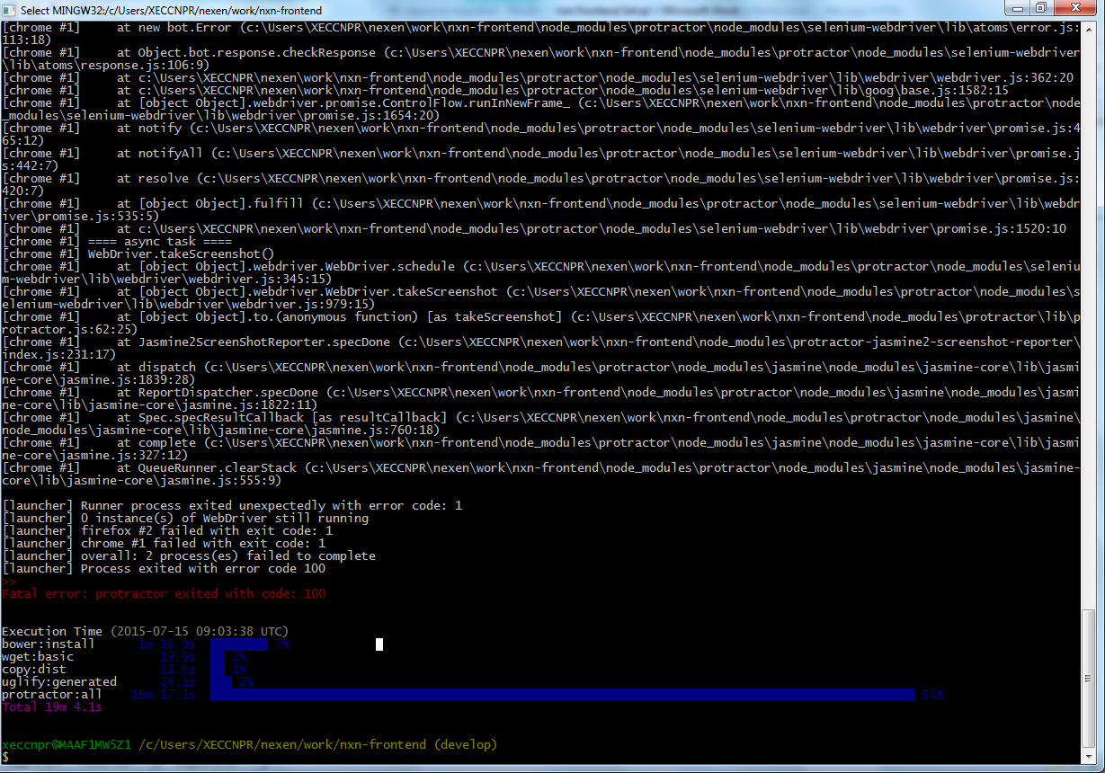
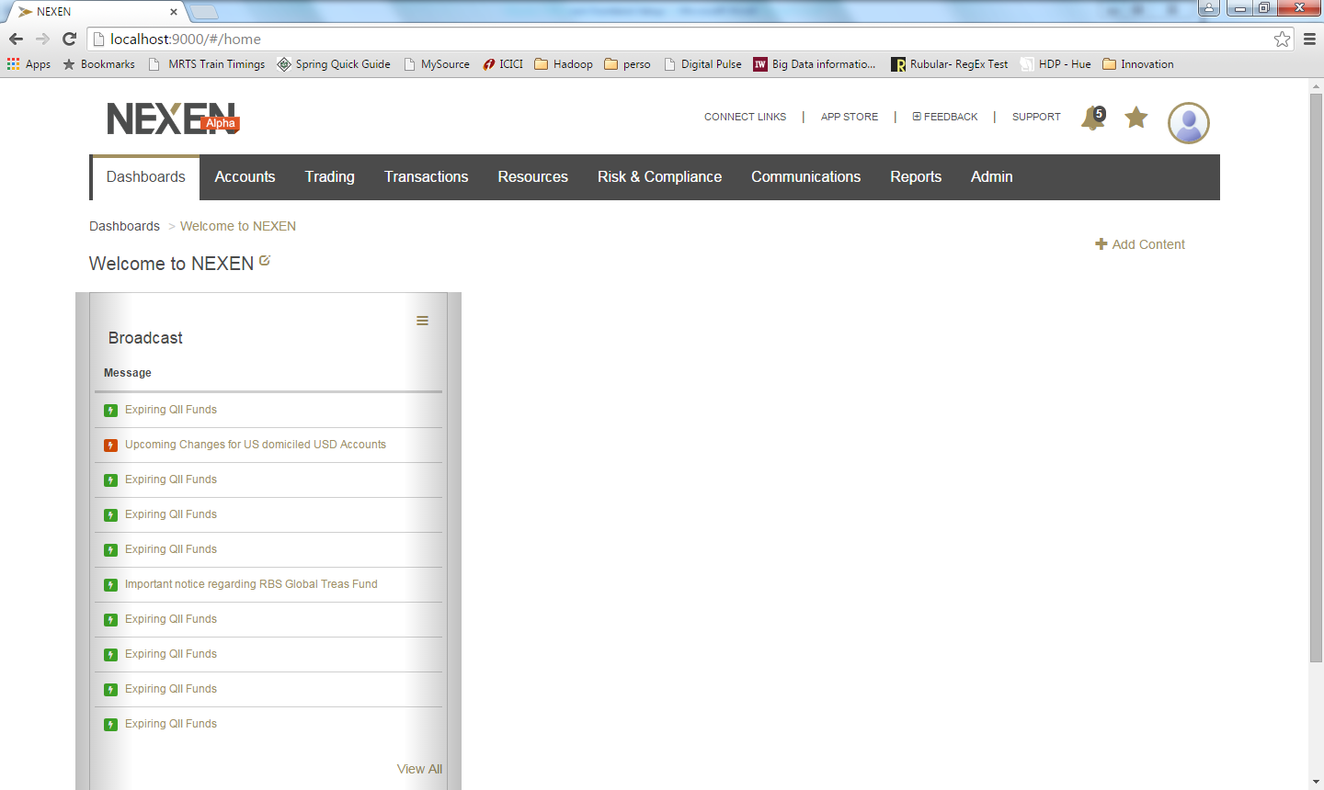
Build ,Test and Run
grunt build - builds the project (includes unit and integration testing)
This step might take quite a long and finally will launch browser. Automated test cases will run for quite a long time. Upon completion the following screen will be displayed.
grunt build-notests - builds the project (excludes testing)
To run nxn-frontend project that launches a browser instance with the following URL http://localhost:9000/#/login
grunt serve - runs the project with mock data.
grunt serve:nomock - runs the project with real data from nxn-service
Any user id /password (both 5chars length)
Anytime when Nexen prompts for PIN, enter 1234567890.

Slide 11
SETTING UP NEXEN SERVICE
To clone nxn-service
git clone http://dev-gitlab.bnymellon.net/nexen/nxn-service.git
For nxn-service database setup
cd dev-setup/db
./setup.sh create ORACLE_PASSWORD
Move into nxn-service and execute following commands
mvn clean install - to clean and install nxn-service
mvn jetty:run - to run nxn-service
To rebuild DB from the scratch
cd dev-setup/db
./refresh.sh ORACLE_PASSWORD
To populate DB with data
mvn –Pdb-deploy install

Slide 12
REFERENCE
Running nxn-frontend https://mysourcesocial.bnymellon.net/docs/DOC-18598
Running nxn-service https://mysourcesocial.bnymellon.net/docs/DOC-25888
MySource Stack
MySource Stack is an internal Stack Overflow collaboration tool that can be quite helpful in socializing FAQs.
https://mysourcestack.bnymellon.net/

Slide 13
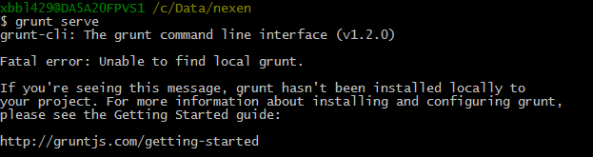
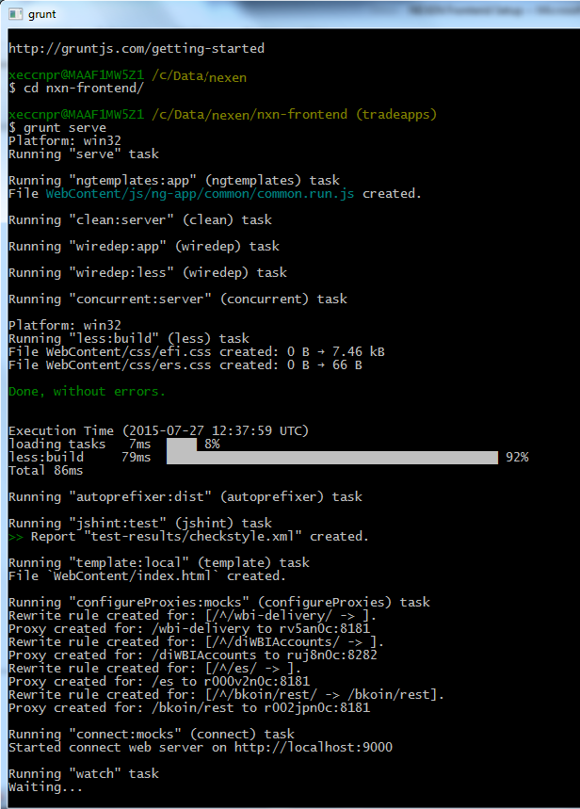
Issues and Resolution
grunt serve – unable to find local grunt
When launch Git Bash, the default directory is c:\user\<comit>\nexen\work
If we run “grunt serve” from this location, the following error will be thrown
Change directory to “nxn-frontend” and then “grunt serve” will work

Slide 14
Walkthrough on NXN-FrontEnd Folder Structure

